Slide 1
Template Engines with Express
Notes:
.

Slide 2
Template Engine
A template engine enables you to use static template files in your application.
At runtime, the template engine replaces variables in a template file with actual values, and transforms the template into an HTML file sent to the client.
This approach makes it easier to design an HTML page.
Some popular template engines that work with Express are Pug, Mustache, and EJS but it also supports several others

Slide 3
Template Settings
To render template files, set the following application setting properties:
views, the directory where the template files are located. Eg: app.set('views', './views'). This defaults to the views directory in the application root directory.
view engine, the template engine to use. For example, to use the Pug template engine: app.set('view engine', 'pug').
Then install the corresponding template engine npm package; for example to install Pug: npm install pug --save

Slide 4
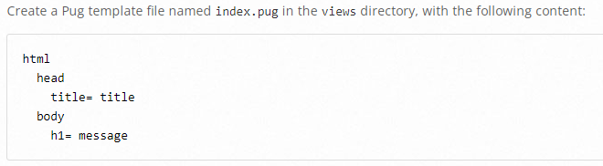
Template Rendering
App.js
const express = require("express");
const path = require("path");
const app = express();
const port = "8000";
app.set("views", path.join(__dirname, "views"));
app.set("view engine", "pug");
app.get('/', (req, res) => {
res.render('index', { title: 'Hey', message: 'Hello there!' })
})
app.listen(port, () => {
console.log(`Listening to requests on http://localhost:${port}`);
});

Slide 5
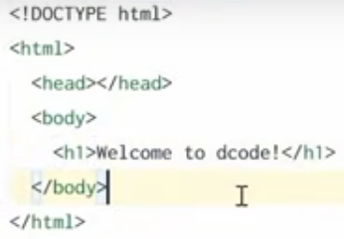
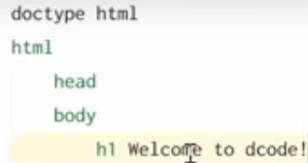
Pug Basics

Slide 6
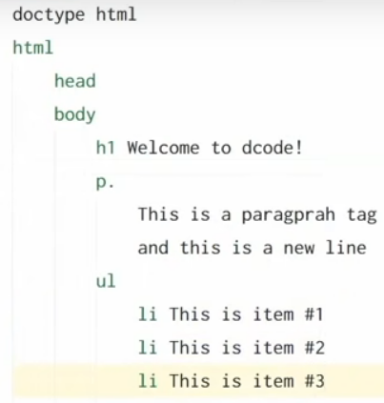
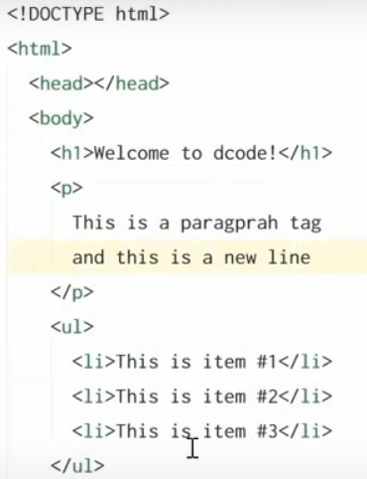
Pug Basics

Slide 7
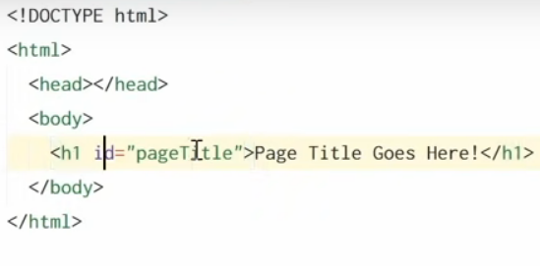
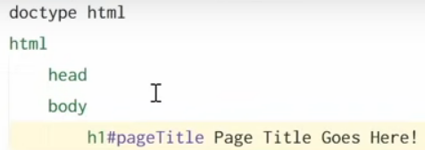
IDs and Classes

Slide 8
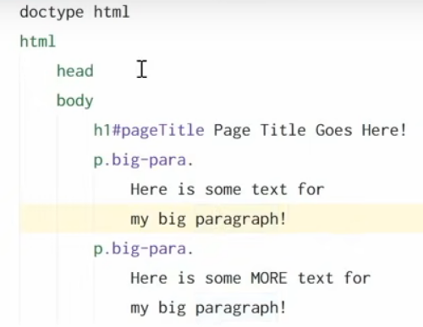
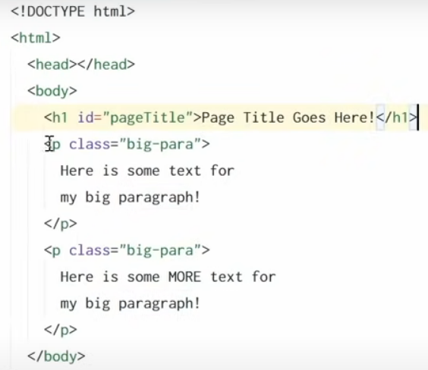
IDs and Classes

Slide 9
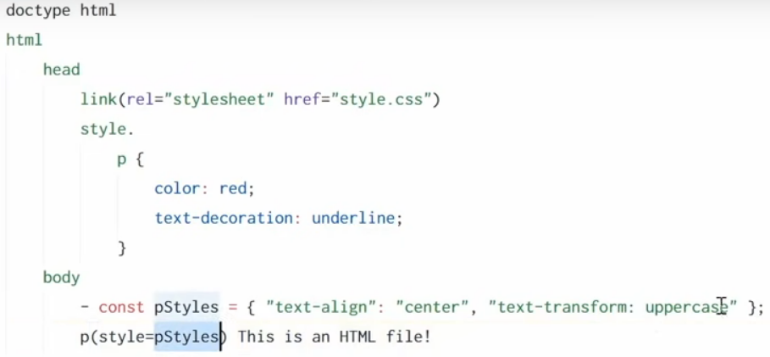
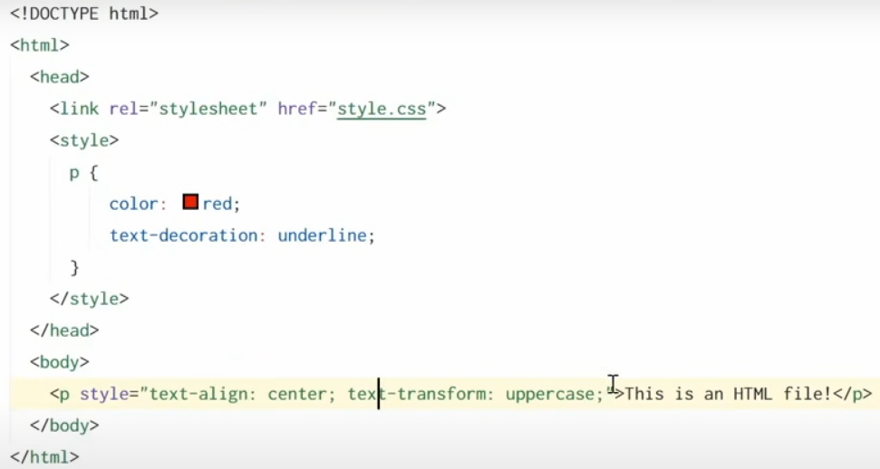
Using CSS (Styles)

Slide 10
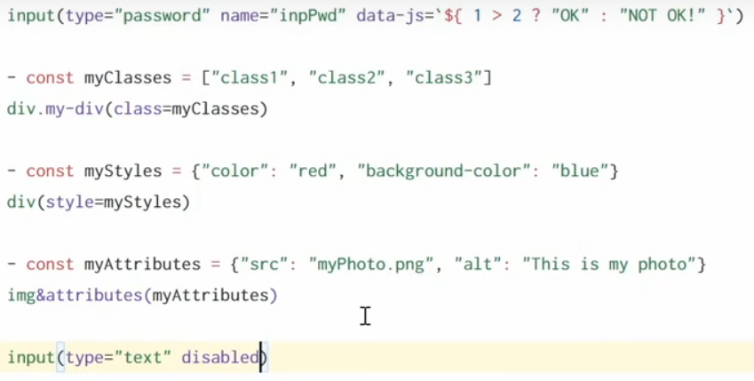
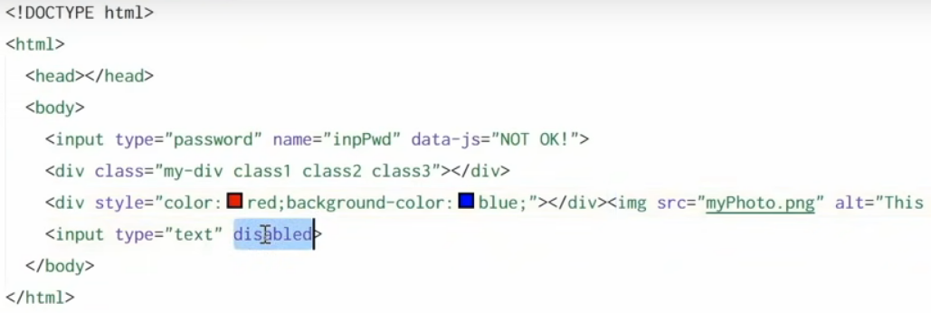
Using CSS (Styles)

Slide 11
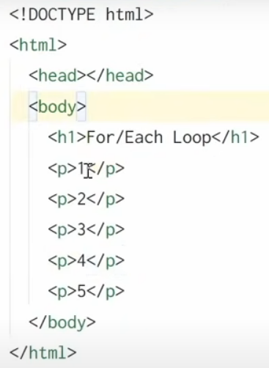
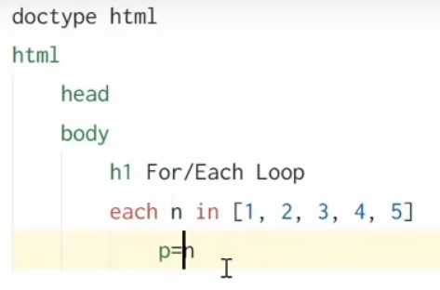
For Each Loop

Slide 12
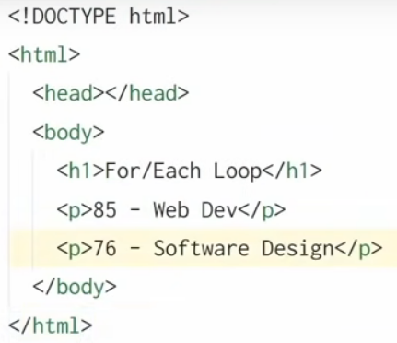
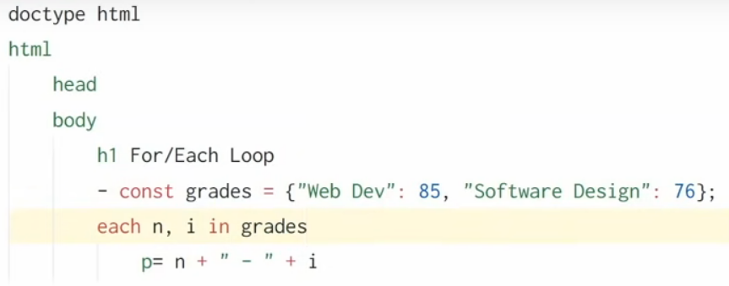
For Each Loop

Slide 13
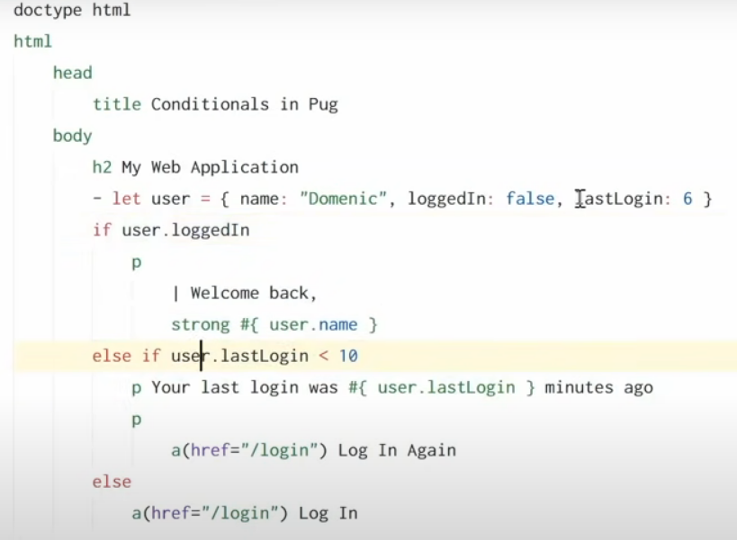
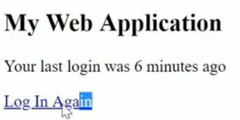
Conditionals IF/ELSE Statement

Slide 14
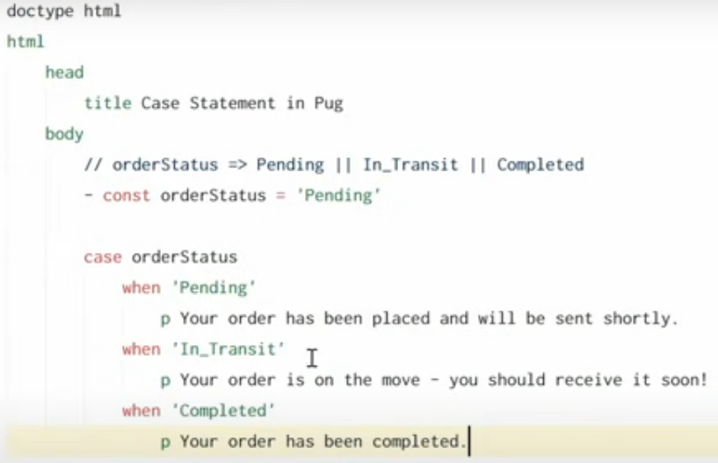
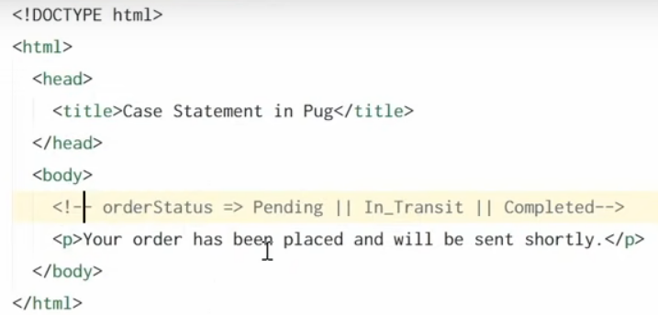
Switch Case

Slide 15
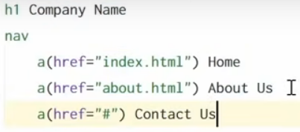
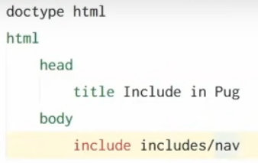
Include Statement
includes/nav.pug
index.pug

Slide 16
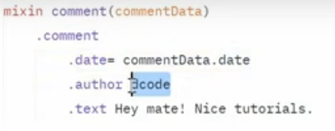
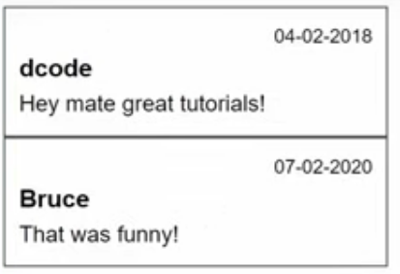
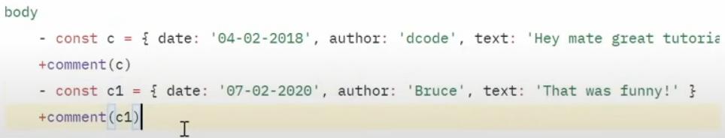
Mixins (Reusable blocks of code)

Slide 17
TASK
Design a Web Page template which includes Header , Footer and main contents. (Include statement)
In main Contents generate dynamic list of Products (Product ID, Product name, Product Photo)– (ForEach Loop)

